Slide 1
Discursis: a tool for aiding the temporal analysis of communication data
Prof Daniel Angus Digital Media Research Centre Queensland University of Technology, Australia
Adapted by Marius Mather, Sydney Informatics Hub

Slide 2
Timeline of Development
2008-2012: Discursis first developed as part of the ARC Thinking Systems Special Initiative Grant (Wiles, Smith, Angus)
2014-2017: ARC Discovery Project ‘Evaluating recurrence as a measure of change in interpersonal dynamics’ (Wiles, Angus, Chenery)
2018-2019: HK Polytechnic - Visual analysis of communication in health care: Extending Discursis software to Cantonese data sets (Angus, Watson, Turnbull, Yau)
2021+: Australian Text Analytics Platform

Slide 3
Conversation meets Computation
Communication Analytics

Slide 4
A non-CS view of conversation
More than just information transmission and reception:
Rapport building
Establishing power / dominance
Ritualistic behaviours

Slide 5
Natural Language Processing
Part of speech tagging
Sentiment Analysis
Coreference resolution
Speech processing
Boundary detection
Topic modelling

Slide 6
Topic Models
Wordnet
Linguistic Inquiry and Wordcount (LIWC)
Sentiment Analysis
Latent Semantic Analysis
Latent Dirichlet Allocation
Leximancer

Slide 7
LIWC
Dictionaries (dimensions) of word categories, e.g. negative affect, power, family, certainty, etc.
Top-down coded, does not deal well with socially grounded meaning.
Highly transparent, and easily understood.
Tausczik, Y.R., & Pennebaker, J.W. (2010). The psychological meaning of words: LIWC and computerized text analysis methods. Journal of Language and Social Psychology, 29, 24-54.

Slide 8
Discursis
Determines the main topics of a conversation
Revealing how these topics are used/reused by conversation participants
… revealing the heartbeat of the conversation
Angus, D., Smith, A., & Wiles, J. (2012). Conceptual recurrence plots: Revealing patterns in human discourse. IEEE transactions on Visualization and Computer Graphics, 18(6), 988-997.

Slide 9
Discursis + Health Communication
Conversation Analytic Support

Slide 10
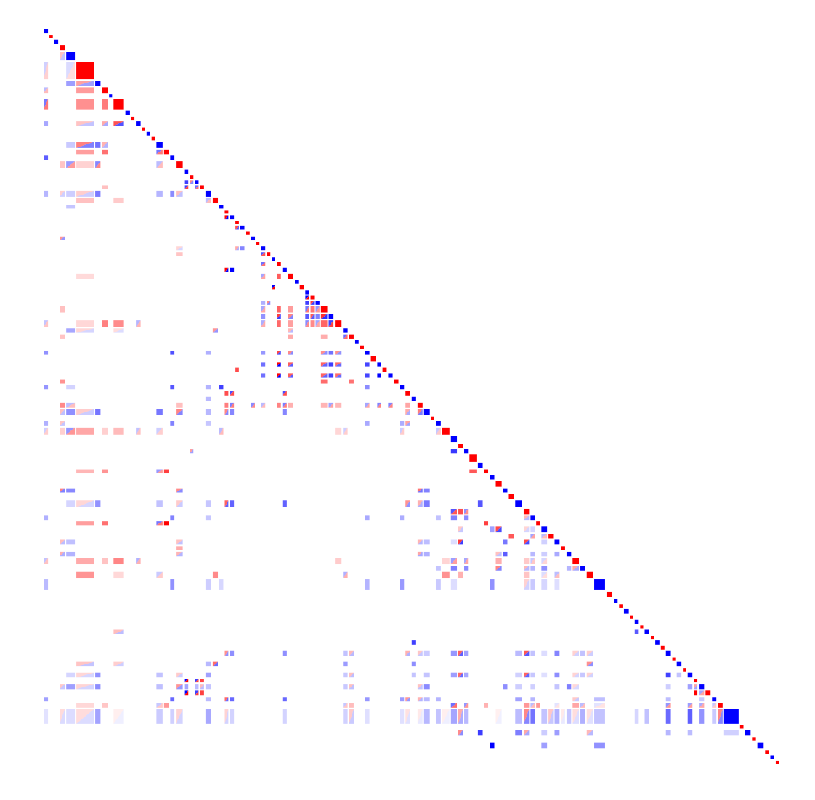
Patient: Yes, well I’ve had dizzy spells as such for oh many years erm in fact looking back I’d say probably from when my children were very young …
■ Doctor
■ Patient
Time
Angus, D., Watson, B., Smith, A., Gallois, C., & Wiles, J. (2012). Visualising conversation structure across time: Insights into effective doctor-patient consultations. PloS one, 7(6), 1-12.
Notes:
Dan: Reveal

Slide 11
Doctor/Patient Consultations
David: Well erm I do have asthma.
Dr: Have you been subscribed anything for your asthma.
David: Erm I take Ventolin.
Dr: Erm, so how long have you been on erm Ventolin.
David: Since um I was erm eighteen I guess.
Dr: So that makes it erm about ten year.
David: Yea.
Dr: so how many times a day do you use your Ventolin puffer.
David: Erm two to three times a day.
Text Transcript
Concept Model
Concept Tagging
Utterance Similarity
Visual Analysis

Slide 12
Words → concepts
Concepts / Topics (10’s - 100’s)
asthma
Ventolin
Evidence terms (1000’s +)
asthma
subscribed
Ventolin
puffer
times
day
Text Transcript
Concept Model
Concept Tagging
Utterance Similarity
Visual Analysis

Slide 13
Utterance Concept Tagging
Look for evidence of concepts in each utterance.
If there is enough evidence to indicate the presence of a concept then code the utterance accordingly.
Text Transcript
Concept Model
Concept Tagging
Utterance Similarity
Visual Analysis

Slide 14
Measuring Utterance Similarity
Utterances are all coded with concept vectors.
All utterance pairs are compared to locate patterns of conceptual similarity.
Text Transcript
Concept Model
Concept Tagging
Utterance Similarity
Visual Analysis
Notes:
Add concept similarity box

Slide 15
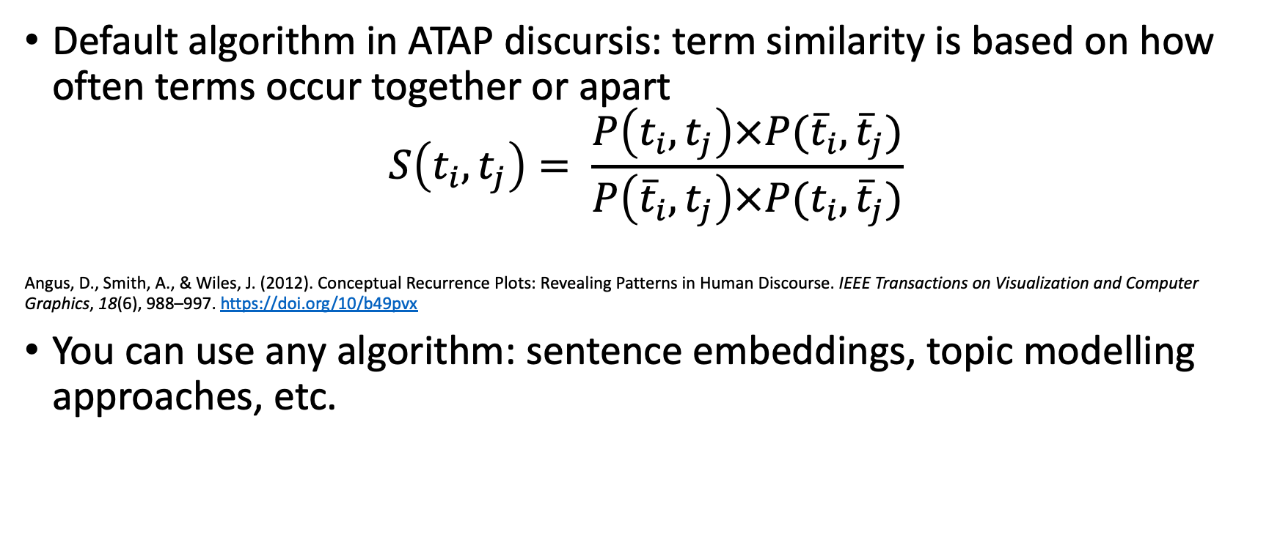
Current similarity algorithm
Default algorithm in ATAP discursis: term similarity is based on how often terms occur together or apart
$$S\left(t_{i}, t_{j}\right)= \frac{P\left(t_{i}, t_{j}\right)×P({\overline{t}}_{i}, {\overline{t}}_{j})}{P\left({\overline{t}}_{i}, t_{j}\right)×P(t_{i}, {\overline{t}}_{j})}$$
Angus, D., Smith, A., & Wiles, J. (2012). Conceptual Recurrence Plots: Revealing Patterns in Human Discourse. IEEE Transactions on Visualization and Computer Graphics, 18(6), 988–997. https://doi.org/10/b49pvx
You can use any algorithm: sentence embeddings, topic modelling approaches, etc.

Slide 16
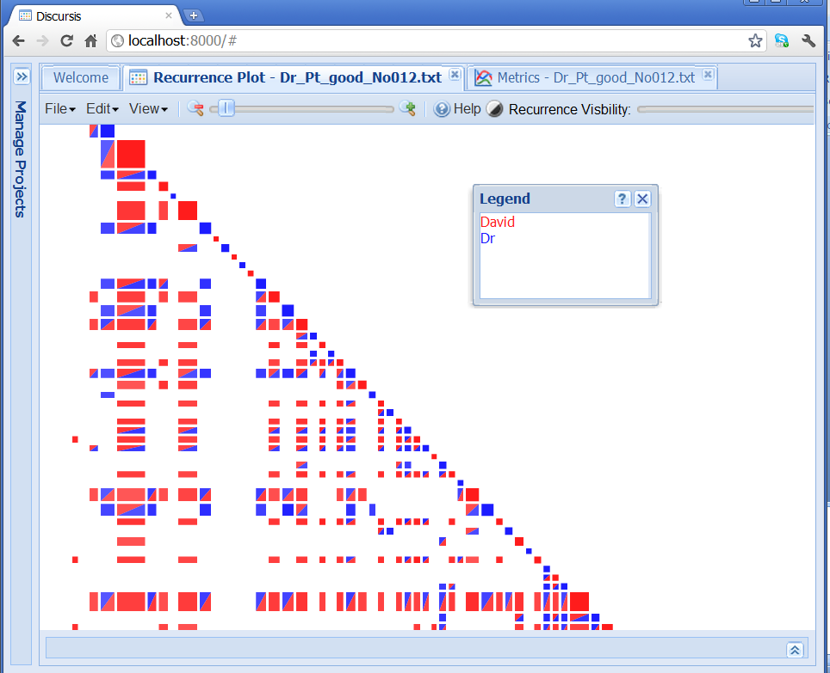
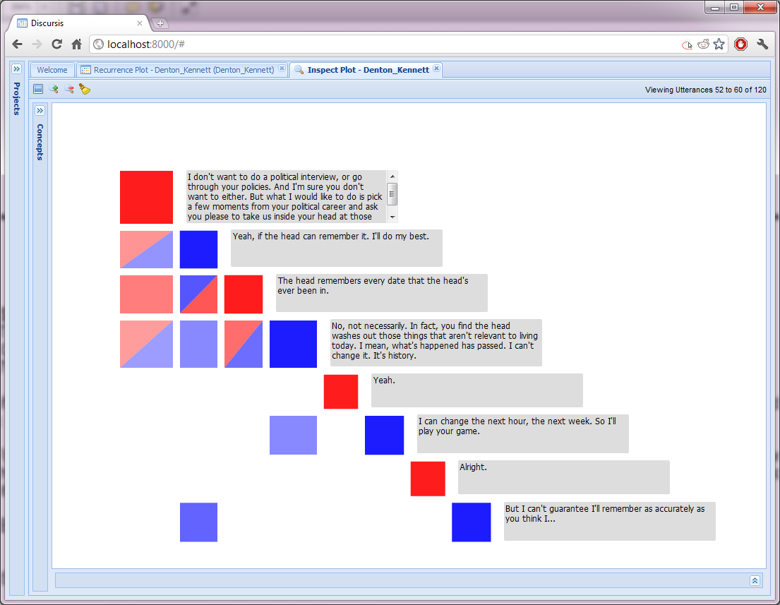
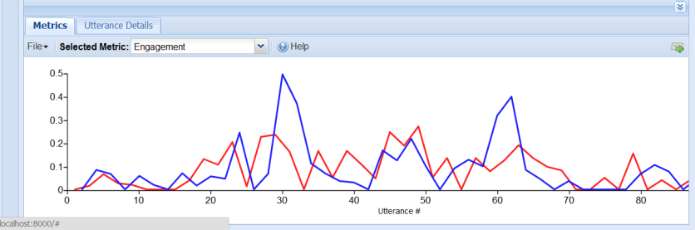
Discursis
Text Transcript
Concept Model
1. Overview
2. Zoom
3. Filter
4. Details on demand
Concept Tagging
Utterance Similarity
Shneiderman, B. (1996, September). The eyes have it: A task by data type taxonomy for information visualizations. In Visual Languages, 1996. Proceedings., IEEE Symposium on (pp. 336-343). IEEE.
Visual Analysis

Slide 17
Introductory
stripe
Engagement
block
■ Doctor
■ Patient
Time
Summary
stripe
Notes:
Local interactions can be viewed along the diagonal.
Things about interactions we know to look for include engagement and listening to the patient for more than 18 Seconds (classic study: Beckman and Frankel 1984).
Dan: redo new discursis plot; ensure opacity is cranked high
Redo other plots

Slide 18
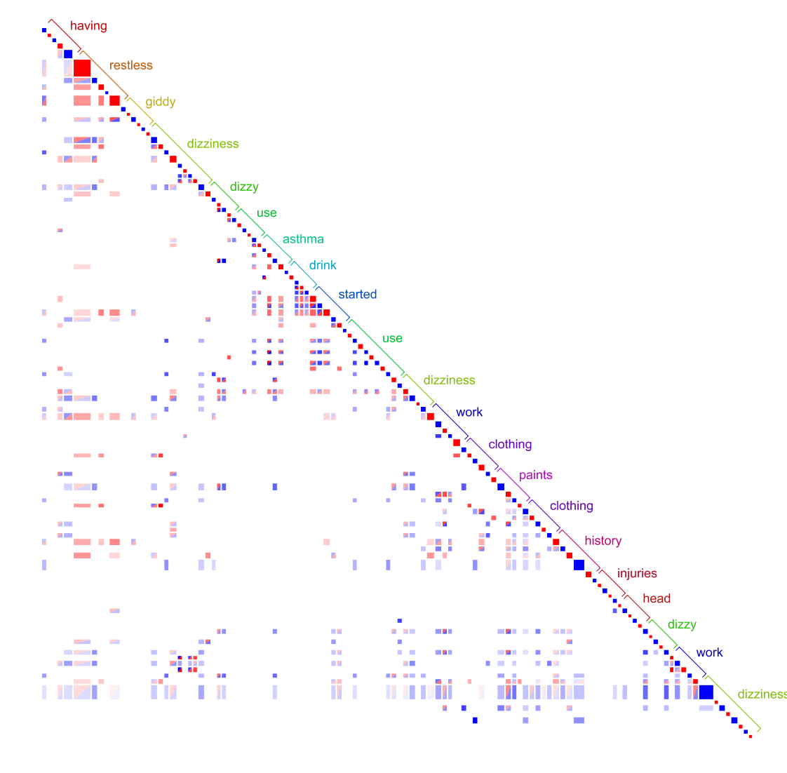
■ Doctor
■ Patient

Slide 19
■ Doctor
■ Patient
■ Doctor
■ Patient
Time
Time
Notes:
Dan: duplicate

Slide 20
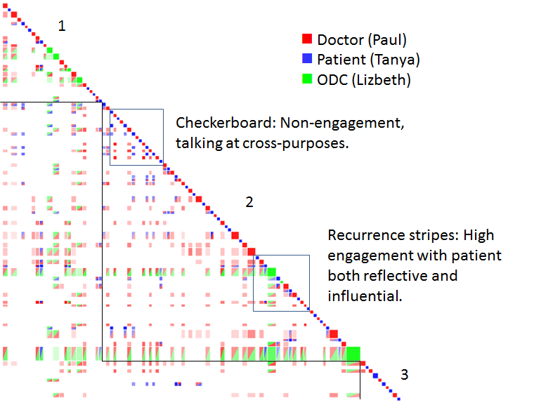
■ Clinician
■ Patient (Tanya)
■ ODC
Watson, B. M., Angus, D., Gore, L., & Farmer, J. (2015). Communication in open disclosure conversations about adverse events in hospitals. Language & Communication, 41, 57-70.
Notes:
Another observation from this scenario is how the clinician and patient are the only speaking
parties in the first 2/3 of the second phase.
When the ODC does speak he or she speaks for a long time and this period of speech by the ODC in the second phase recurs strongly
with previous utterances, indicated by the strong horizontal recurrence stripe. Interestingly
the utterance by the ODC recurs mostly with the clinician rather than the patient. After this
particular utterance the clinician RED is seen to recur strongly with the ODC’s utterance due to the vertical
recurrence stripe. It is likely that this one utterance offers a summary of what the clinician has discussed in the scenario to date,
while also encouraging discussion around these topics in the remainder of the scenario.
GO IN AND HAVE A LOOK AT WHAT IS SAID

Slide 21
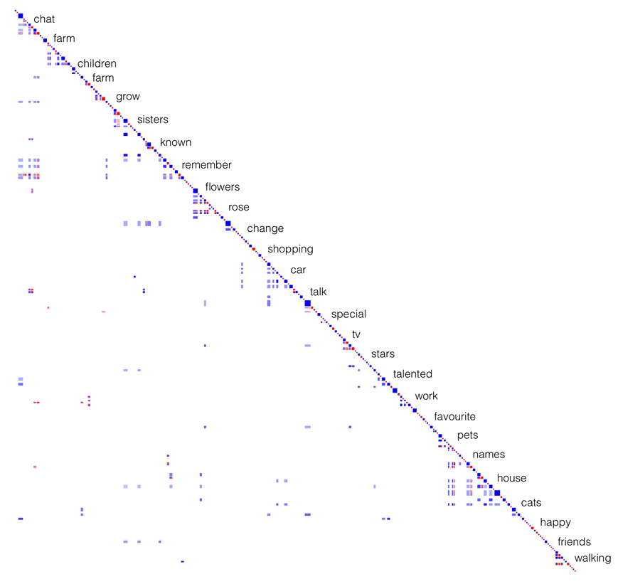
■ Care Provider
■ Person with Dementia
Baker, R., Angus, D., Smith-Conway, E. R., Baker, K. S., Gallois, C., Smith, A., ... & Chenery, H. J. (2015). Visualising conversations between care home staff and residents with dementia. Ageing & Society, 35(2), 270-297.
Notes:
Rosemary and Katherine have been working with Discursis over the past year (Dan’s comment was that they could practically run this workshop!)

Slide 22
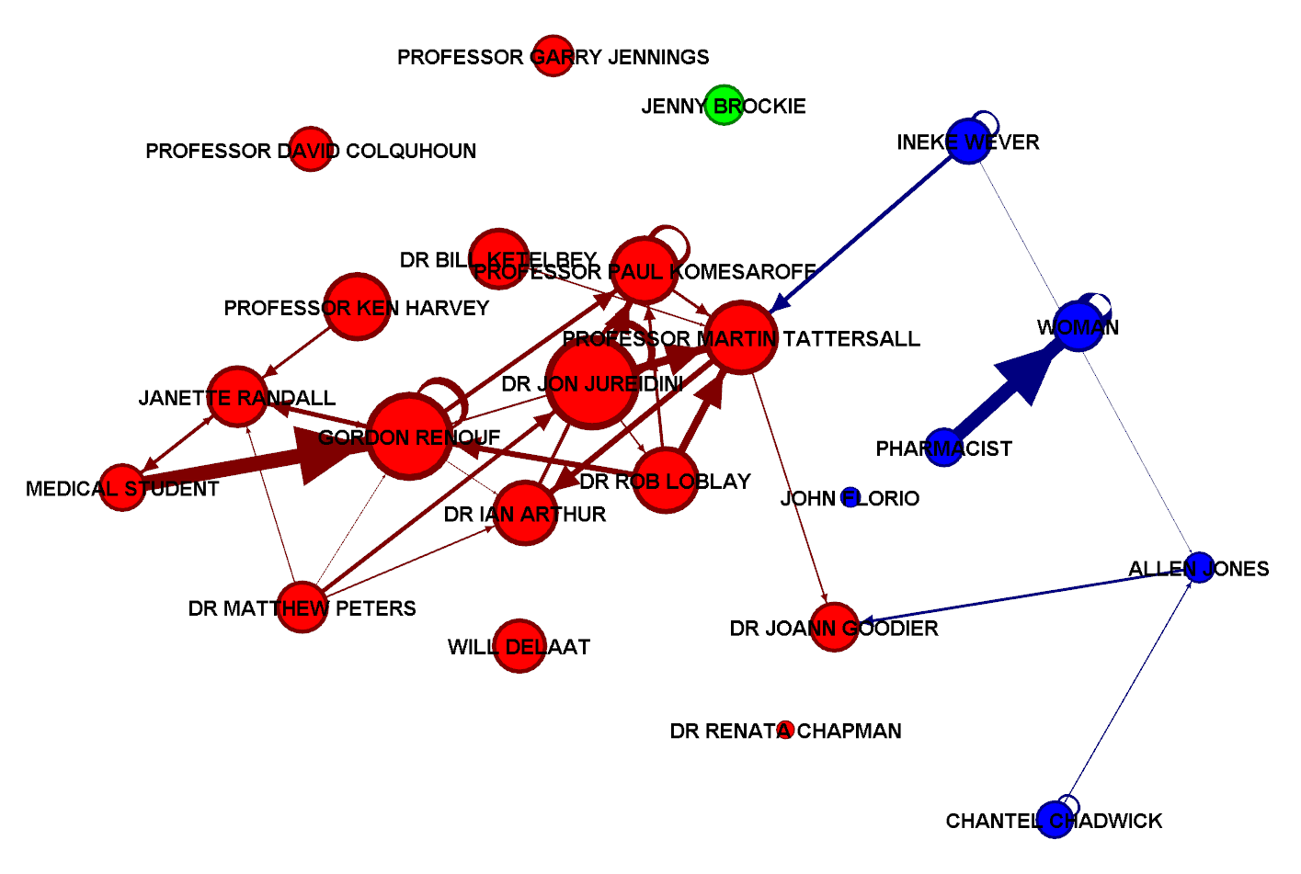

Mutiparty discourse workflows
Angus, Daniel & Wiles, Janet (2018) Social semantic networks: Measuring topic management in discourse using a pyramid of conceptual recurrence metrics. Chaos, 28(8), Article number: 085723 1-12.

Slide 23
Resources
Try a live demo at: https://github.com/Australian-Text-Analytics-Platform/discursis/
Find other tools and workshops at https://www.atap.edu.au/
Discursis references:
Angus, D. (2019). Recurrence Methods for Communication Data, Reflecting on 20 Years of Progress. Frontiers in Applied Mathematics and Statistics, 5. https://www.frontiersin.org/articles/10.3389/fams.2019.00054
Angus, D., Smith, A., & Wiles, J. (2012). Conceptual Recurrence Plots: Revealing Patterns in Human Discourse. IEEE Transactions on Visualization and Computer Graphics, 18(6), 988–997. https://doi.org/10/b49pvx
Angus, D., Smith, A. E., & Wiles, J. (2012). Human Communication as Coupled Time Series: Quantifying Multi-Participant Recurrence. IEEE Transactions on Audio, Speech, and Language Processing, 20(6), 1795–1807. https://doi.org/10.1109/TASL.2012.2189566

